Slide 1
Preventing Discharge to No Fixed Address-Youth (NFA-Y) Cheryl Forchuk RN PhD O Ont FCAHS Beryl and Richard Ivey Research Chair in Aging, Mental Health, Rehabilitation and Recovery London, ON, Canada
Cheryl Forchuk, Sandra Fisman, JULIA RENNICK, Carolina dale,steve Cordes, Katherine Krakowski, Jason Galindo, Matthew Forget, Melissa Jeffrey, Anne Peters

Slide 2
Sponsors
Thank you to our funders for sponsoring this important work:
The Networks of Centres of Excellence (NCE)
Making the Shift (MtS) Youth Social Innovation Lab
Canada Mortgage and Housing Corporation (CMHC)’s National Housing Strategy.

Slide 3
Community Partners

Slide 4
NFA Y: Program evaluation
No Fixed Address – Youth (NFA – Y)
The NFA-Y evaluation tests the effectiveness of a potential best practice intervention for preventing discharge into homelessness for youths aged 16-25
Purpose: help psychiatric inpatient youth who are at-risk of being discharged to homelessness find stable housing upon hospital discharge
Clients across two hospitals access the program referral from health care provider
NFA-Y Program Overview
Find stable housing
Access financial support
Transition to Community post-discharge

Slide 5
Why a youth version of NFA?
20% of the homeless population in Canada is comprised of youth between the ages of 13-24. (https://www.homelesshub.ca/about-homelessness/population-specific/youth)
In a given year, there are at least 35,000-40,000 youth experiencing homelessness. (https://www.homelesshub.ca/about-homelessness/population-specific/youth)
The needs of youth differ from the needs of adults

Slide 6
Unique needs of youth
Education Supports
Children’s Aid Society
Youth-Sector Employment
Ontario Works vs ODSP
Sex Trafficking
Housing
Lack of tenancy history
Need for co-signer

Slide 7
No Fixed Address – Youth (NFA – Y)
Staff from Youth Opportunities Unlimited (YOU) assists youth to access:
- shelter - long term housing - supportive housing - private market rentals - and other housing supports
Staff also assists youth with: - navigating community resources - case management - referrals to other community partners for additional supports and dual case management.

Slide 8
No Fixed Address – Youth (NFA – Y)
Helps youth obtain financial assistance through
- Ontario works (OW)
- Ontario Disability Support Program (ODSP) - employment supports.
Works in partnership with the Housing stability bank (HSB) to help youth obtain grants for first and last months’ rent

Slide 9
Research Methods
Administrative data from hospitals, and community agencies will be assessed to determine changes in the rates of discharge from hospital to homelessness
Interviews conducted prior
to discharge, and at 6- and
12-months post-discharge:
Focus groups examine perceptions of the intervention, strengths of the implementation strategy, and suggestions for improving the program

Slide 10
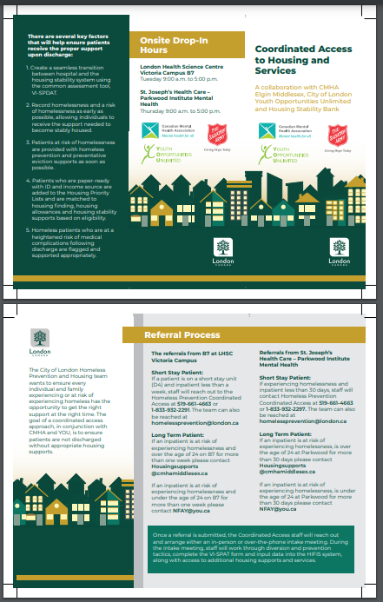
Hospital Poster & Brochure

Slide 11
Housing for youth (September 2023)
Out of the 32 unique individuals met this year, 30 have been diverted from homelessness
6 Live in Private Market Rentals
2 live in YOU Corner Stone Transitional Housing
4 Living in YOU Shelter
6 have returned to live with family
1 Youth in St. Leonard’s Transitional Housing
9 Youth matched to housing programs through the City of London
2 Youth Living in CMHA Transitional Housing

Slide 12
Results: Participant demographics
Interview 1
Inclusion
Ages 16-24*
Homeless or at-risk of homelessness
Program Utilization
Interview Sample
N=27
Age: M=20.3, SD=2.9
Psychiatric inpatient
11 Male (40.7%); 15 Females (55.6%); 1 Transgender (3.7%)
(As of September 2023)
Ethnic/Racial/Cultural group (Missing: n=1)
European origins (Caucasian): n=17
Indigenous: n=3
Visible minority: n=6
N=32

Slide 13
Results: Participant Psychiatric Diagnosis
Psychiatric Diagnosis(es) Type | Interview 1 N(%)
Developmental Disorders (e.g., autism, learning disability) | 5 (18.5%)
Anxiety Disorder | 12 (44.4%)
Disorder of Childhood/Adolescence (e.g., ADHD) | 5 (18.5%)
Schizophrenia | 9 (33.3%)
Mood Disorder | 18 (66.7%)
PTSD | 4 (14.8%)
Other | 2 (7.4%)
Psychiatric Diagnosis(es) | Interview 1 N(%)
Yes | 27 (100.0%)
Single Diagnosis | 8 (29.6%)
Multiple Diagnosis | 19 (70.4%)

Slide 14
Results: Participant Physical Diagnosis
Physical Health Diagnosis(es) Type | Interview 1 N(%)
Heart Condition | 2 (7.4%)
Arthritis | 1 (3.7%)
Respiratory Illnesses | 2 (7.4%)
Epilepsy | 1 (3.7%)
Other | 8 (29.6%)
Physical Health Diagnosis(es) | Interview 1 N(%)
Yes | 13 (48.1%)
Single Diagnosis | 12 (44.4%)
Multiple Diagnosis | 1 (3.7%)
Notes:
Other includes:
Back pain – 1
Headache/joint pain – 1
High cholesterol – 1
Knee tumor – 1
Legally blind in right eye – 1
Low iron, cyst – 1
Muscle atrophy syndrome/gastroparesis – 1
Severe stomach acid reflux – 1

Slide 15
Results: Participant Homelessness
Homelessness | Interview 1: Yes N(%) | Interview 2: Yes N(%) | Interview 3: Yes (N%)
Absolute Homeless (current) | 20 (74.1%) | 6 (31.6%) | 2 (14.3%)
Risk of Homeless (current) | 7 (25.9%) | 5 (26.3%) | 2 (14.3%)
Absolutely Homeless (past year) | 18 (66.0%) | 16 (84.2%) | 12 (85.7%)

Slide 16
Results From focus groups for NFA Y and H²I (adult) programs
Communication
Collaboration
Coordination
Outcomes

Slide 17
Communication
The collaborative approach allows for improved communications between agencies to provide improved care for clients
The use of focus groups to identify issues and address them allows for continuous improvement of the program

Slide 18
Collaboration
This program has many different agencies with diverse perspectives and experiences
This program involves engaging community partners, using the services they have to offer
Having youth with lived experience on the advisory committee provides for an invaluable perspective in the implementation of the program

Slide 19
Coordination
Having a single, internal contact to network between the participating agencies to streamline access to housing
The use of a centralized database (HIFIS) means that different agencies can continue being involved in patient care beyond a single encounter

Slide 20
Outcomes
“What’s gone well is actually the amount of people that have been supported into housing through our diversion and prevention efforts”
The NFA Y program has been so successful that it has been sustained by LHSC as a permanent program beyond the research funding period

Slide 21
Conclusions: Tips for implementation
Communication
Recognize discharge to homelessness could be a problem in your community.
Collaboration
Work with agencies within your community as partners to address the issue of discharge to homelessness.
collect administrative data on how frequently patients are discharged into homelessness.
Establish relationships with landlords
Coordination
Establish a primary point of contact who can oversee admissions and referrals.
Produce a brochure that contains the contact information of the primary point of contact.

Slide 22
Questions?
Principal Investigator: Cheryl Forchuk
Email: cforchuk@uwo.ca
Community Liaison, Youth Opportunities Unlimited: Matt Forget Email: MattF@you.ca
Project Coordinator: Anne Peters
Email: anne.peters@lhsc.on.ca

